Slide 1
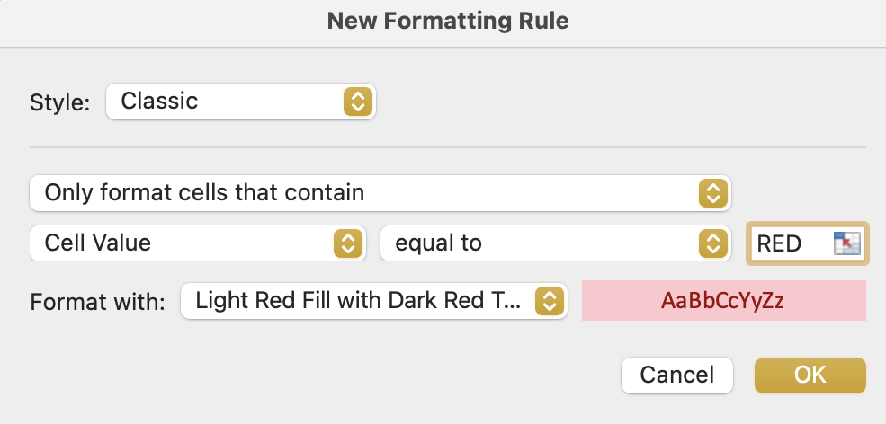
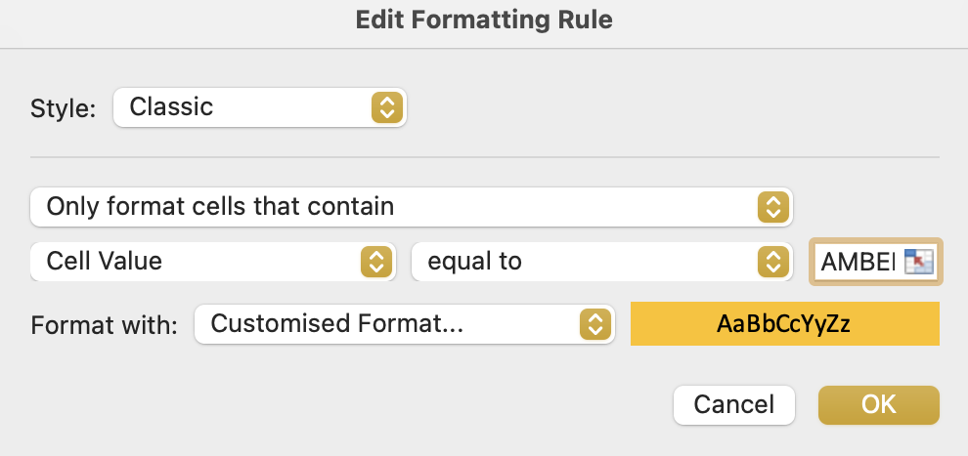
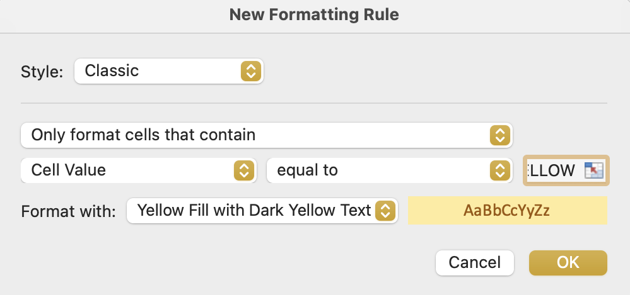
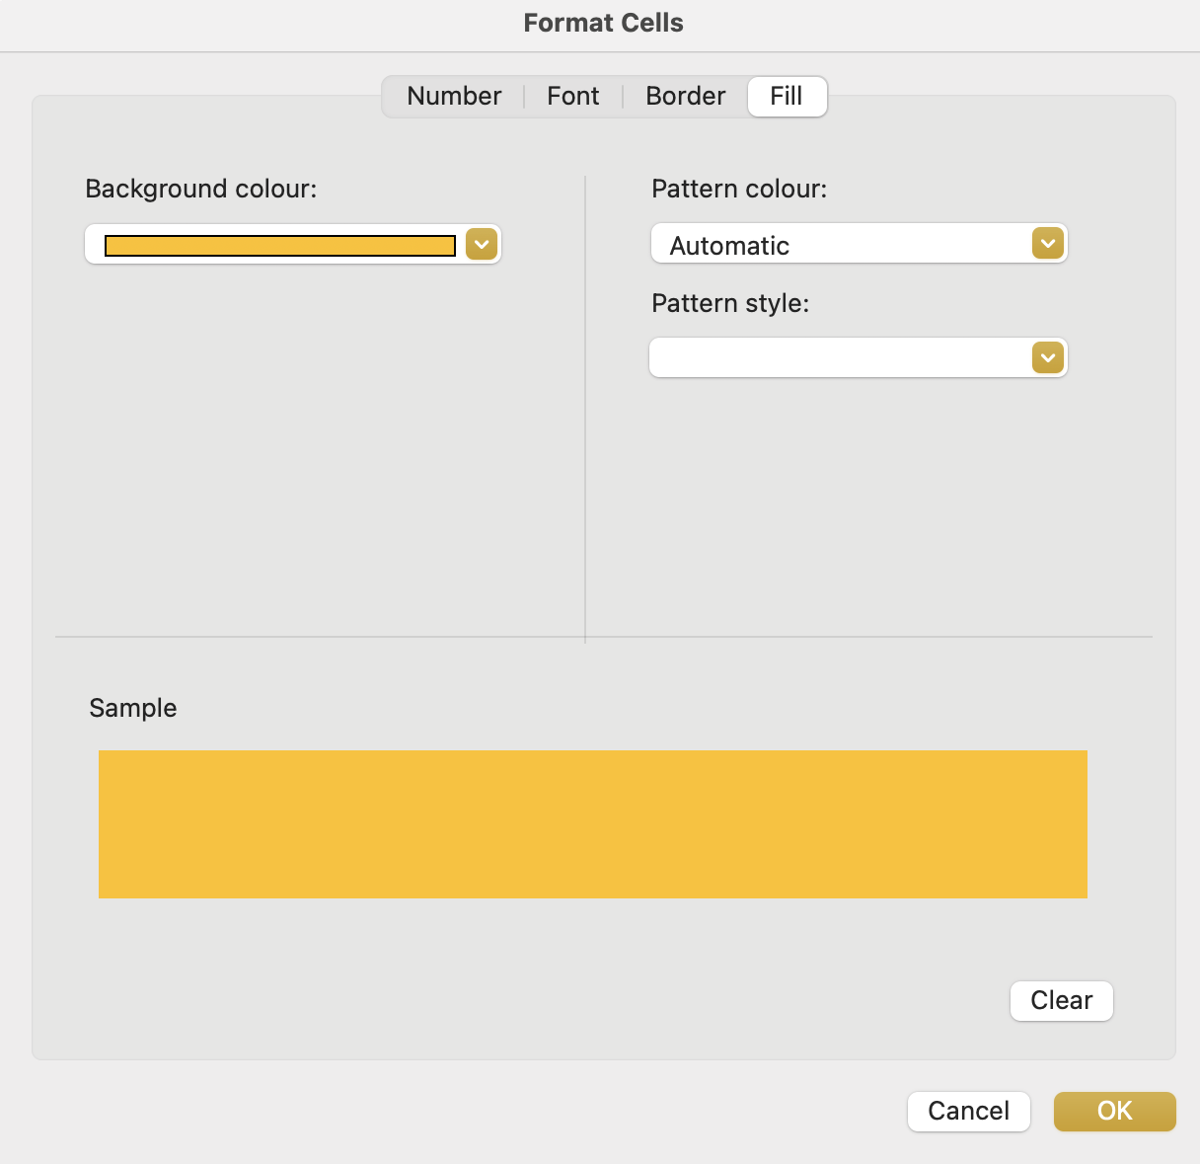
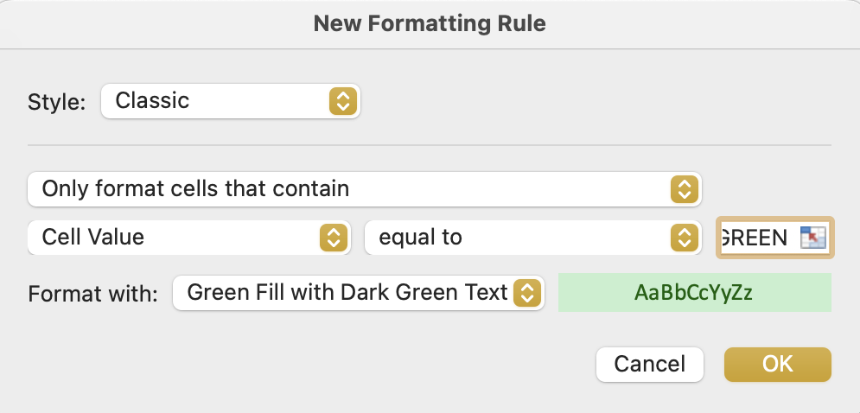
1
Image 26
Type ‘RED’
Select ‘OK’
2
Type ‘AMBER’
Select ‘OK’
2a
3
Note: On this occasion, step 2 states ‘customised Format’. That is because, at the time of creating this rule, there is no drop-down option ‘Amber Fill’. Instead, select the Customised Format, then when the next window opens, select (a) ‘Fill’ tab (b) ‘Amber’ colour (c) ‘OK’.
Type ‘YELLOW’
Select ‘OK’
4
Type ‘GREEN’
Select ‘OK’

