Slide 1
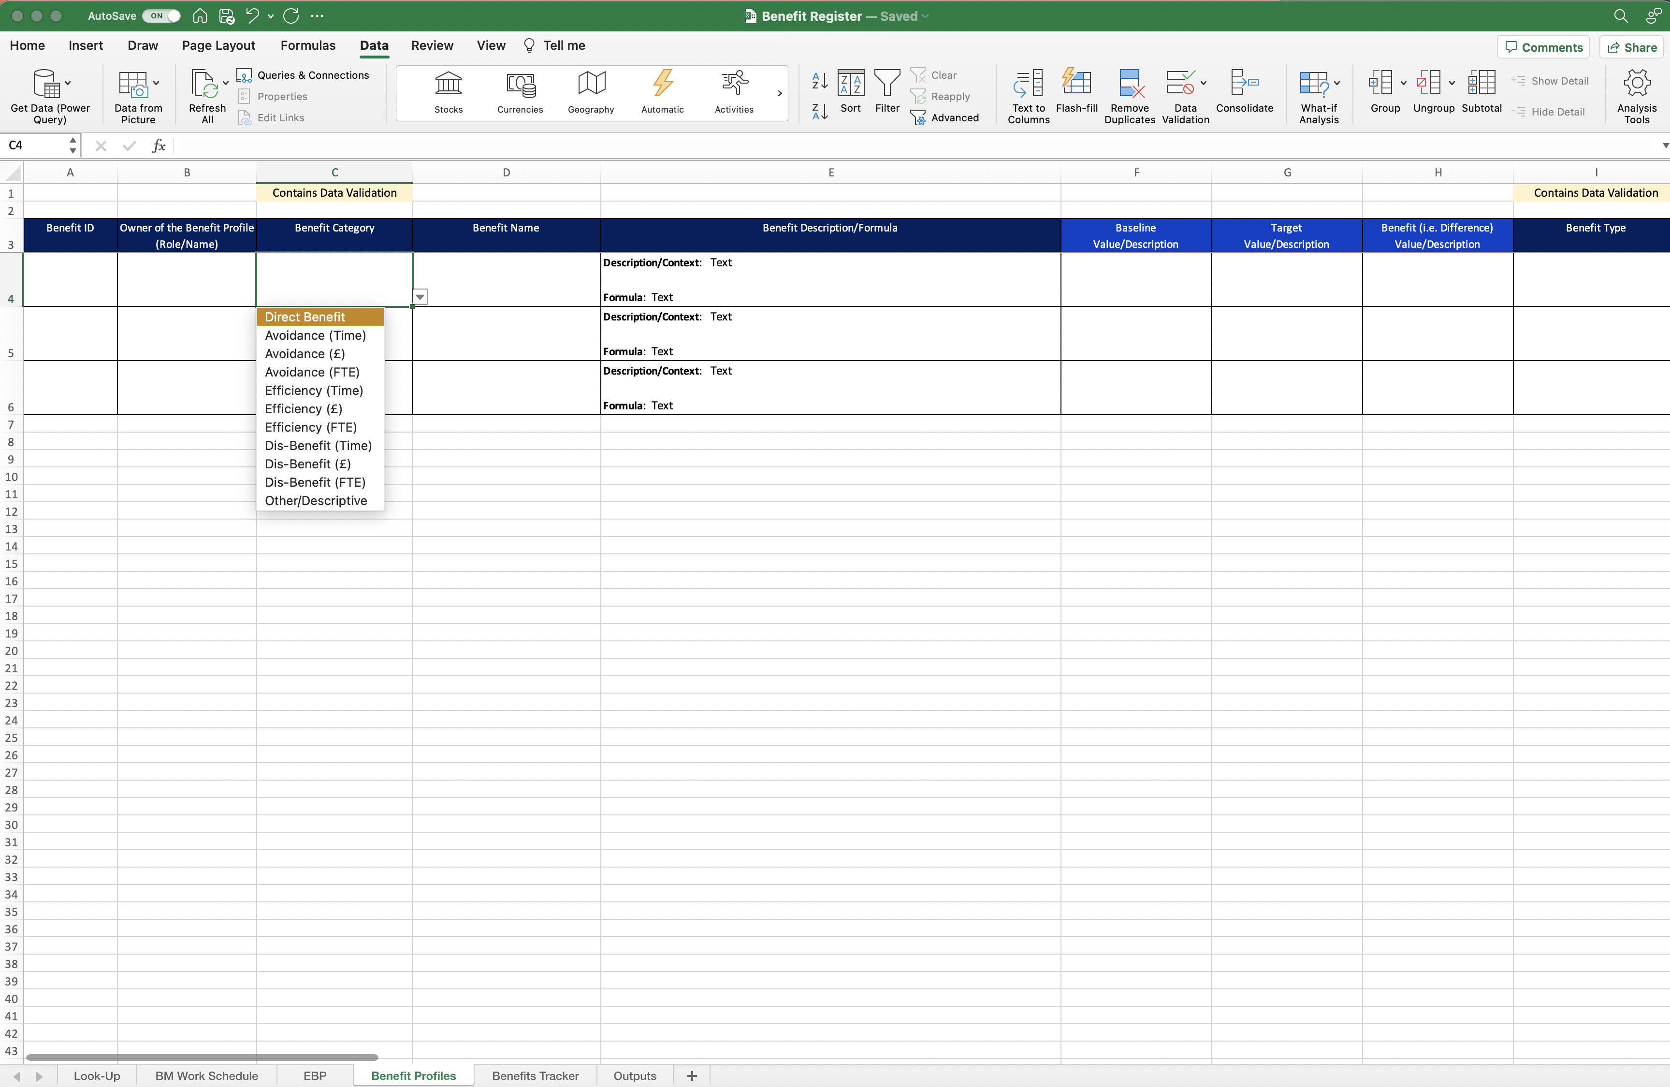
Image 37
When the data validation has been created, Excel will return you to the ‘Benefit Profiles’ worksheet. Select the drop-down arrow to check/see the Data Validation created in the previous steps.
Copy field C4 and paste it into C5 and C6 below.
Check, then complete the data validation steps again for all columns tagged with ‘Contains Data Validations’ (the first rows, of each of the 4 tables in image 32, show where the data validations are required).

